Slide 1

SOCIAL MEDIA
USAGE

Slide 2
GROUP 1
B004 SHRESTH AGRAWAL
B001 ABHISHEK AGGARWAL
B006 ARUNAV ATRISHI

Slide 3
PROBLEM STATEMENT
Understanding social media marketing, basic application of an algorithm used by social media analysts for targeted marketing. Understanding age groups and gender wise number of users and their relevant correlations on a social media platform.

Slide 4
01 THEORY

Slide 5
Theory
What is Correlation?
Correlation is a statistical measure that tells us about the association between the two variables. It describes how one variable behaves if there is some change in the other variable.
What is Pearson’s Correlation Coefficient?
In statistics, the Pearson correlation coefficient is a measure of linear correlation between two sets of data. It is the ratio between the covariance of two variables and the product of their standard deviations; thus it is essentially a normalised measurement of the covariance, such that the result always has a value between −1 and 1.

Slide 6
What is Linear Regression?
Simple linear regression is a model that assesses the relationship between a dependent variable and an independent variable. The simple linear model is expressed using the following equation:
Y = a + bX + c
Where:
Y – Dependent variable
X – Independent (explanatory) variable
a – Intercept
b – Slope
c – Residual (error)

Slide 7
02 DATA USING & CLEANING

Slide 8
DATA USING AND CLEANING
Source of the dataset: Kaggle.
There are 25 independent features and 1 dependent feature in the dataset.
Data used is a training data, which is cleaned.
Data used from the database:
Term | Description
age_group | This is a categorical feature denoting the age of the user. Age of users is divided into 4 groups
gender | Categorical feature representing the gender of the user.
following_rate | Number of accounts followed by the user (feature is normalized)
followers_avg_age | Average of age groups of all the followers of the user.
following_avg_age | Average of age groups of all the accounts followed by the user.

Slide 9
DATA ASSUMPTION
GENDER
AGE
Tier 1: 00-18 years
Tier 2: 18-24 years
Tier 3: 25-30 years
Tier 4: 30 years and over
1= MALE
2= FEMALE

Slide 10
03 IMPLEMENTATION & OUTPUT

Slide 11
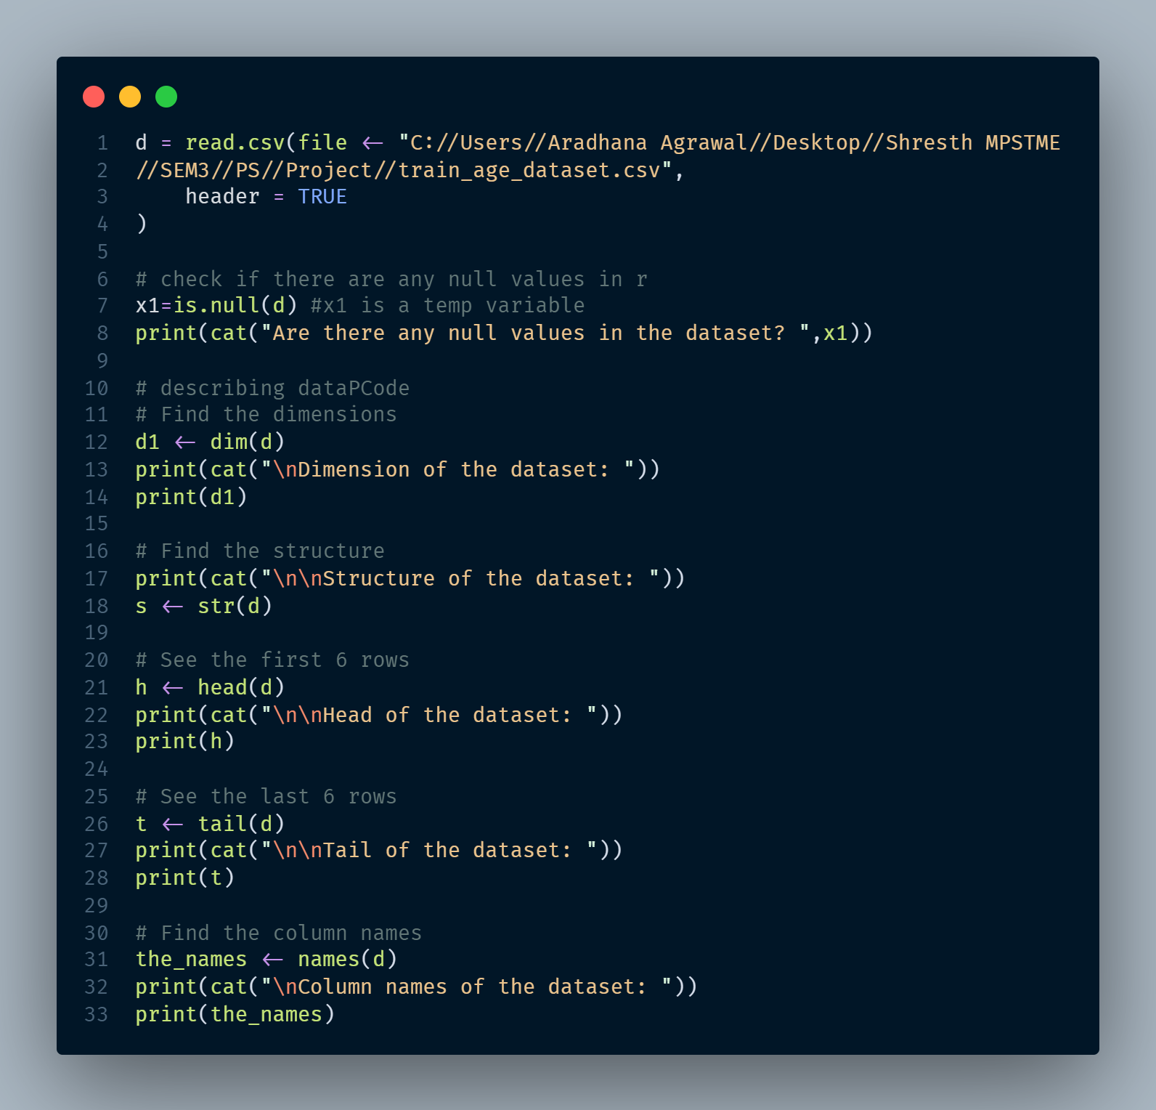
Dataset Description

Slide 12
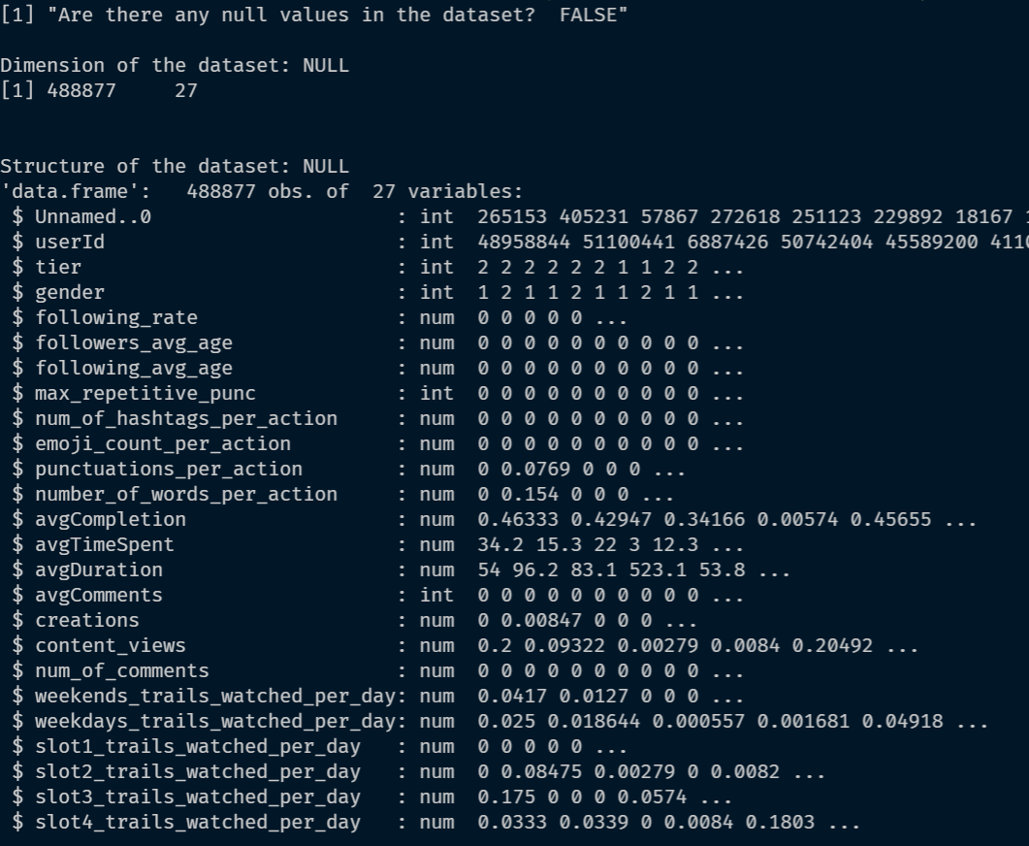
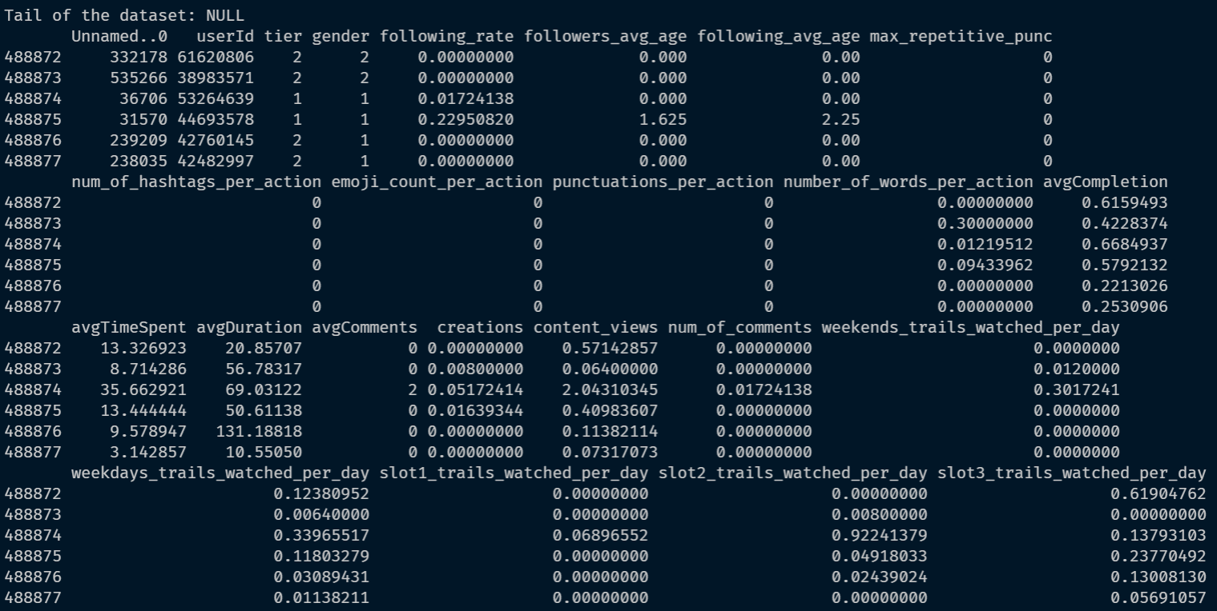
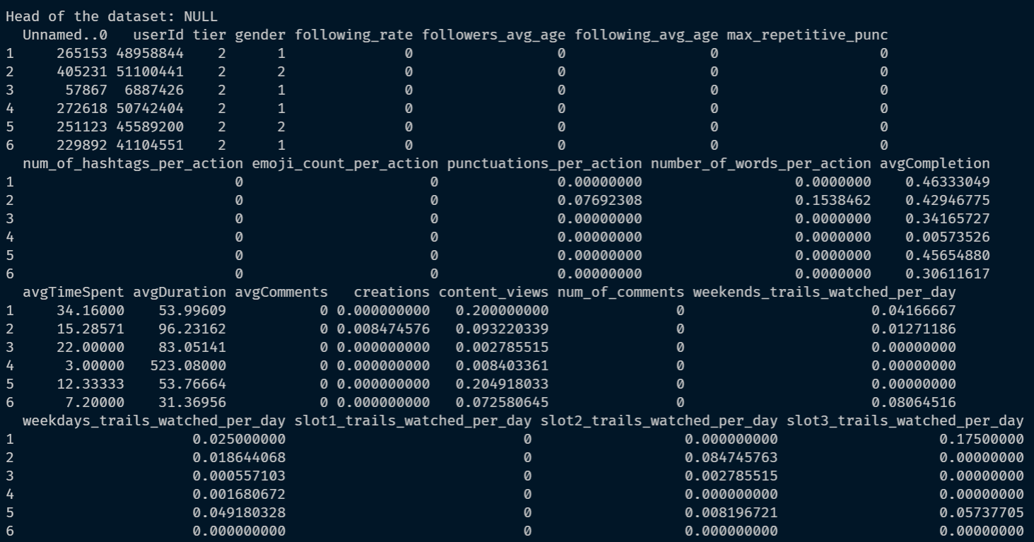
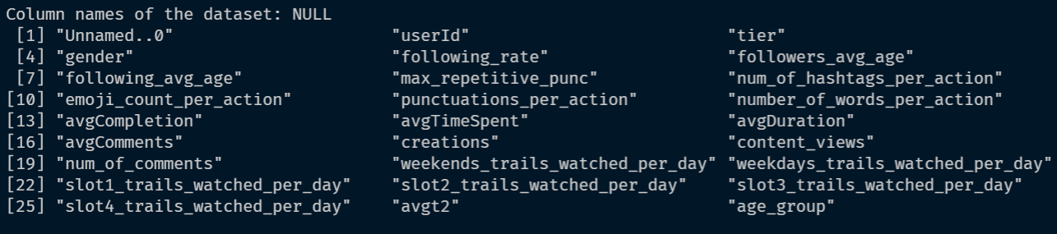

Slide 13
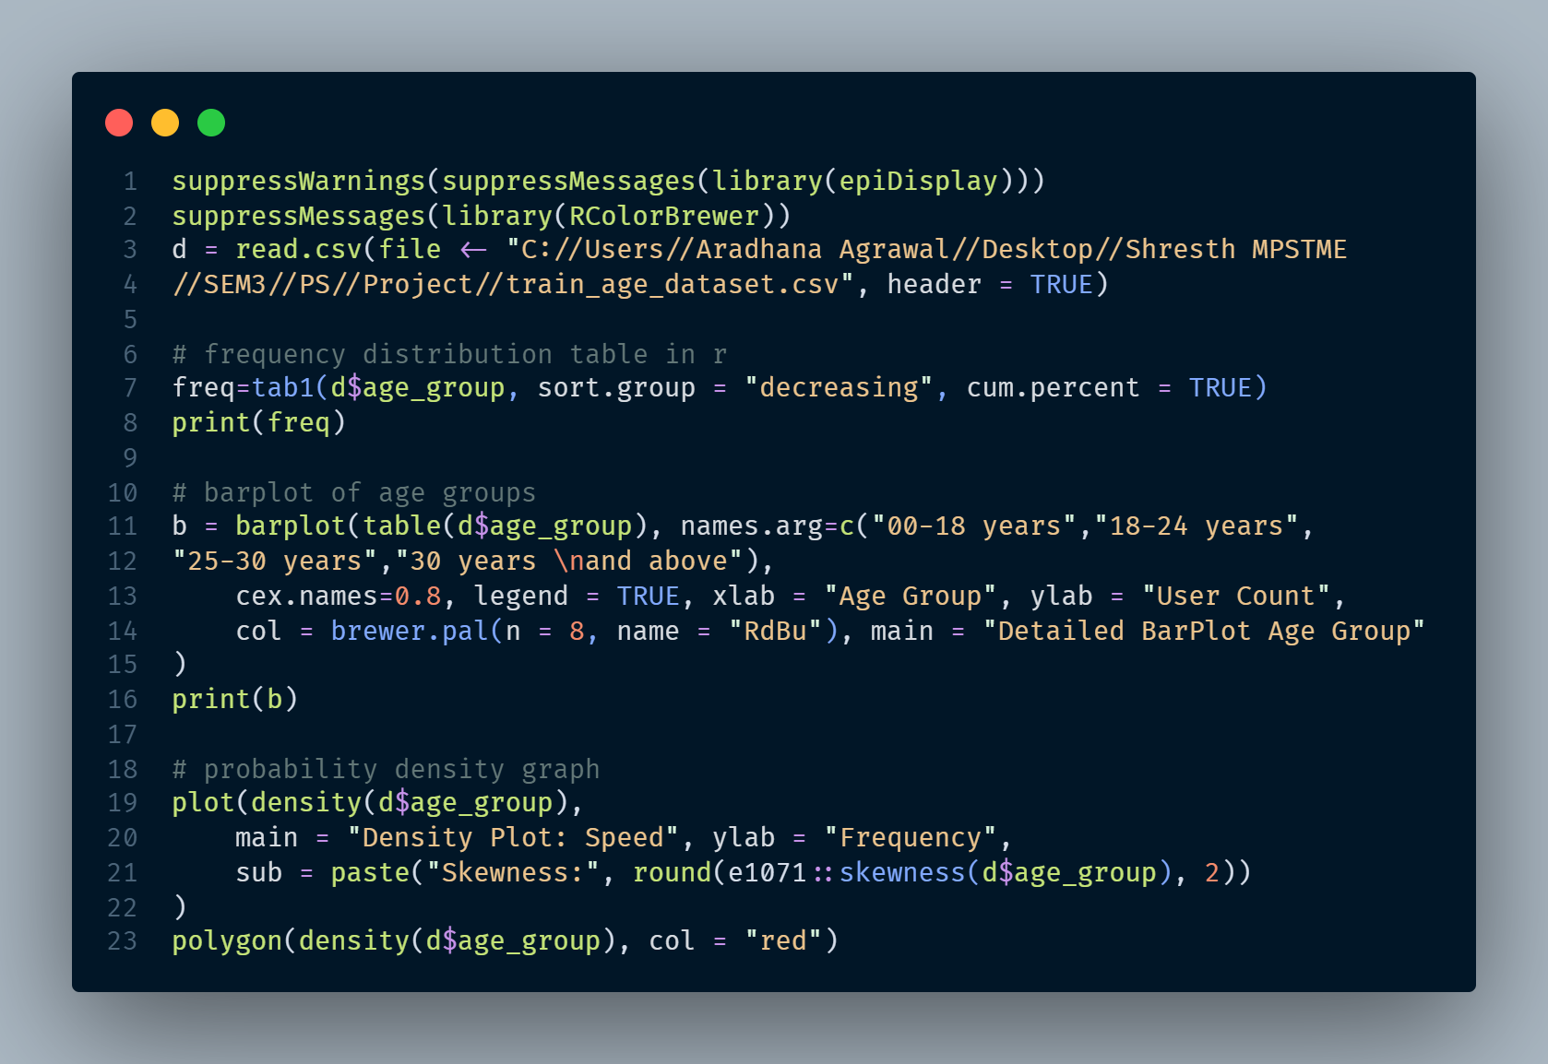
Age Group Frequency Table

Slide 14
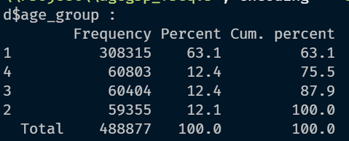
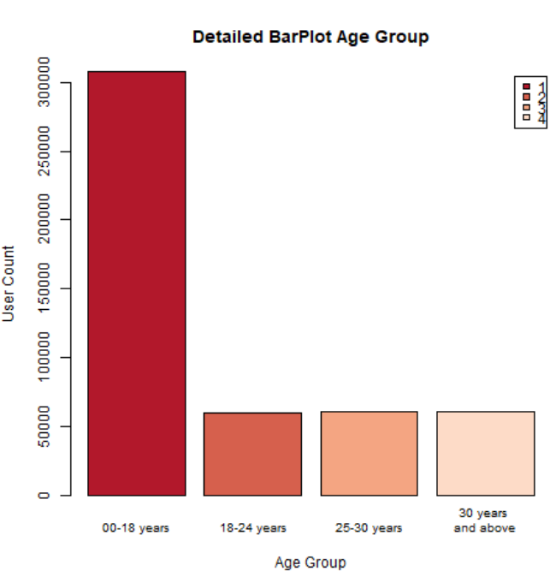
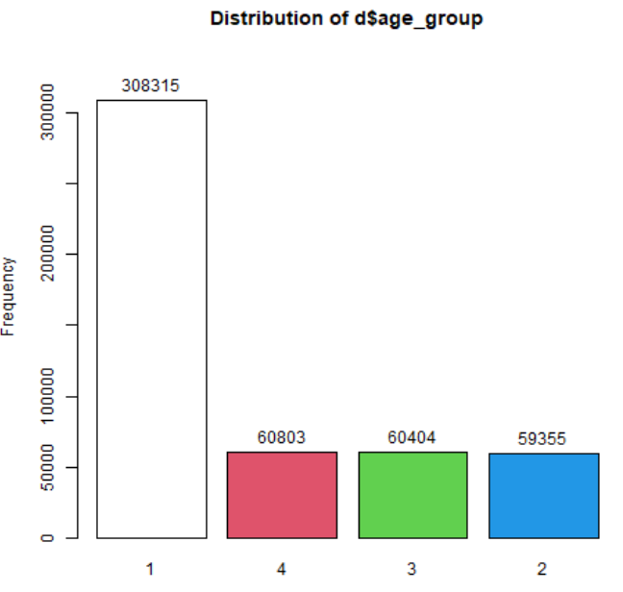
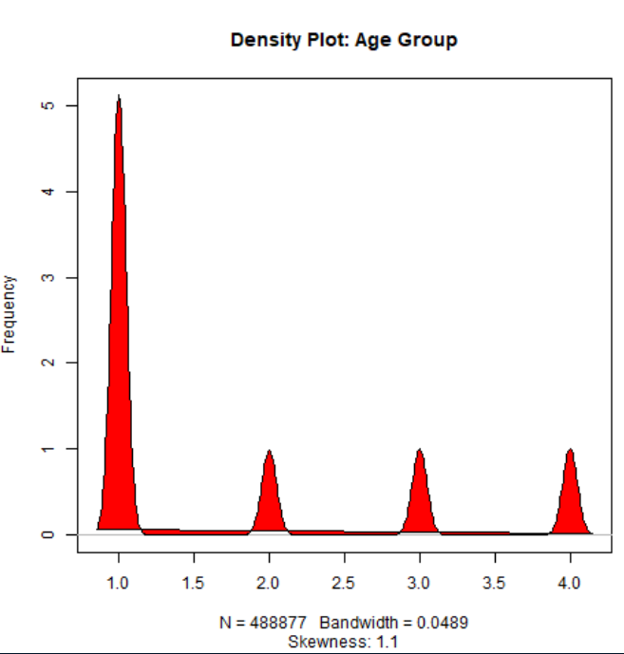
Age Group Frequency Table
Frequency Dist. Table and Graph:
Detailed Bar Plot:
Density Plot:

Slide 15
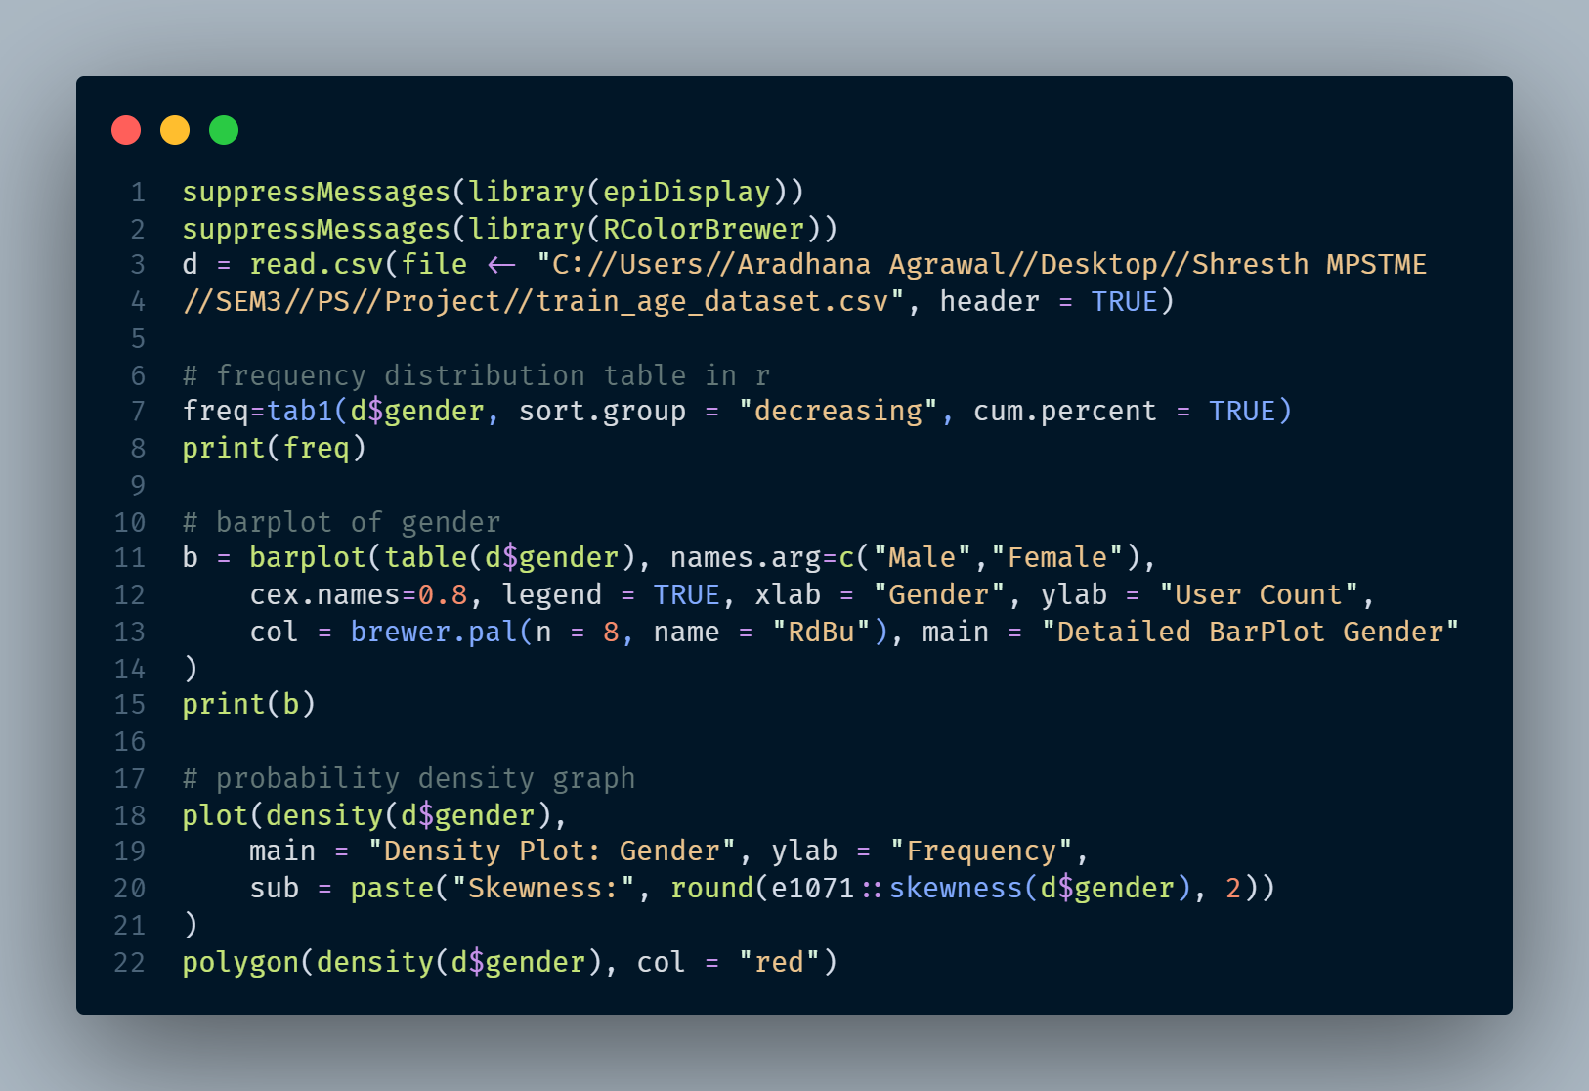
Gender Frequency Table

Slide 16
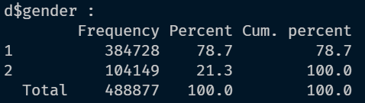
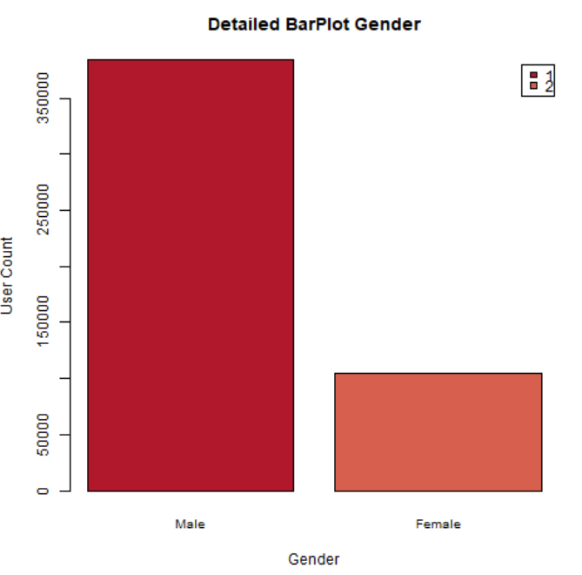
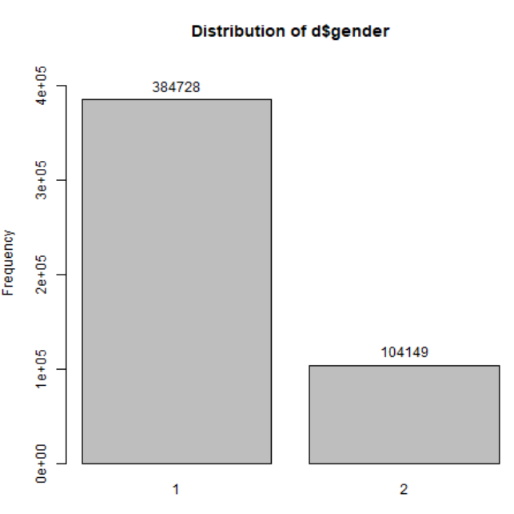
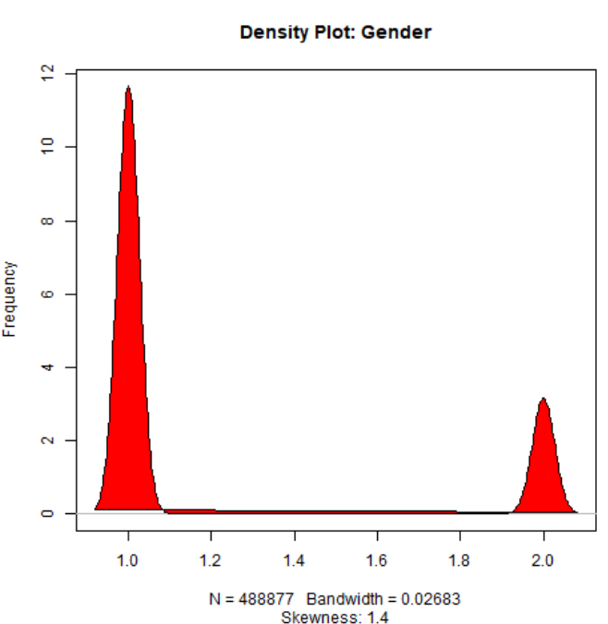
Gender Frequency Table
Frequency Dist. Table and Graph:
Detailed Bar Plot:
Density Plot:

Slide 17
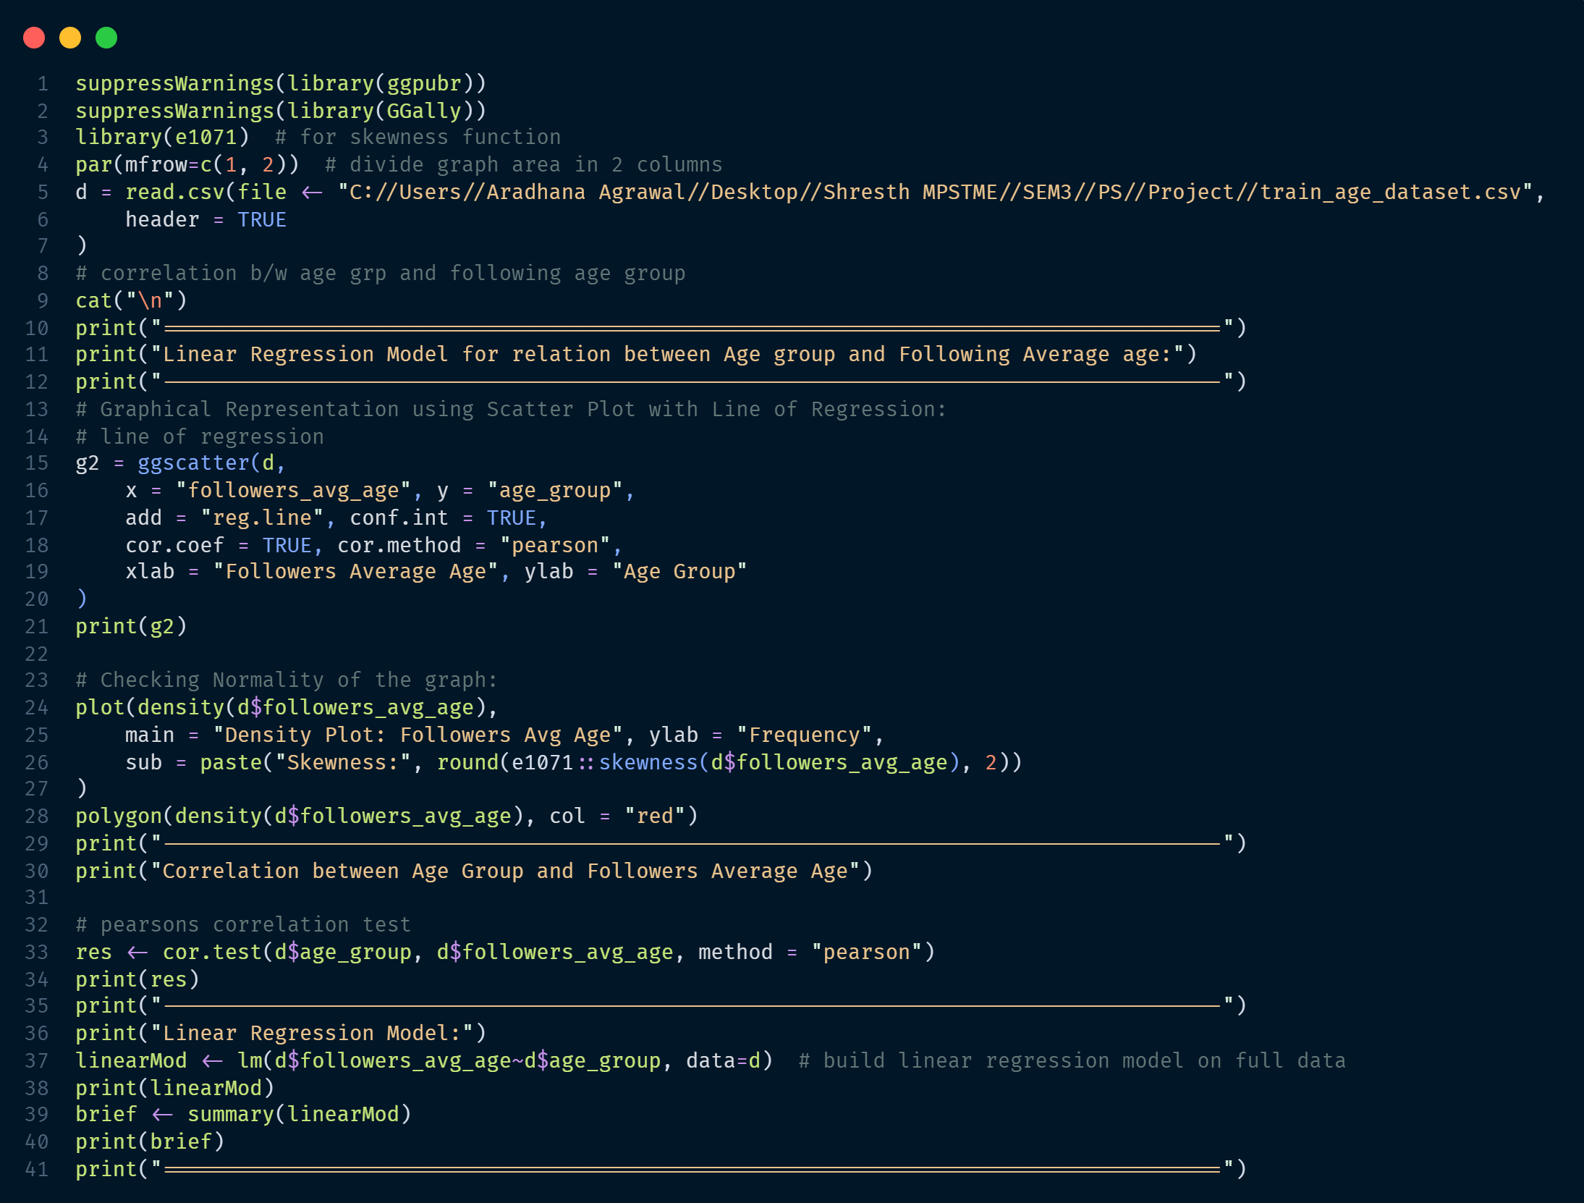
Linear Regression Model (Age Grp vs Followers Avg Age)

Slide 18
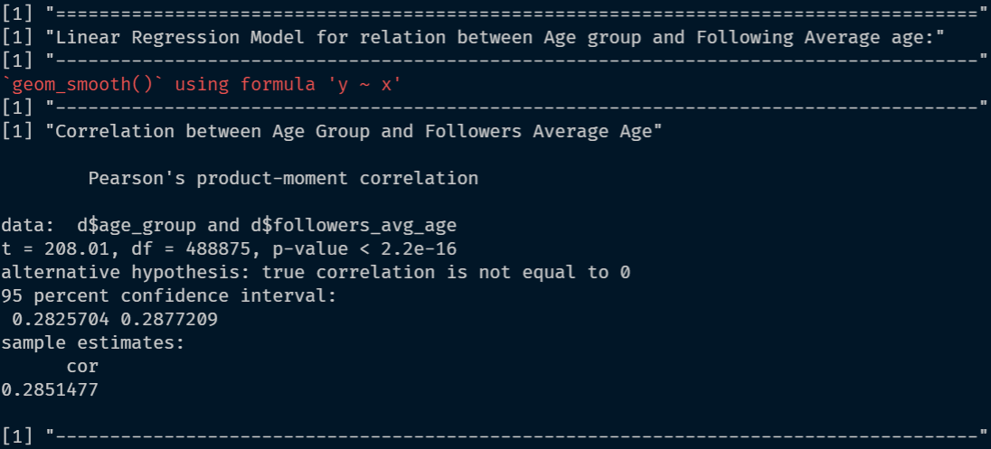
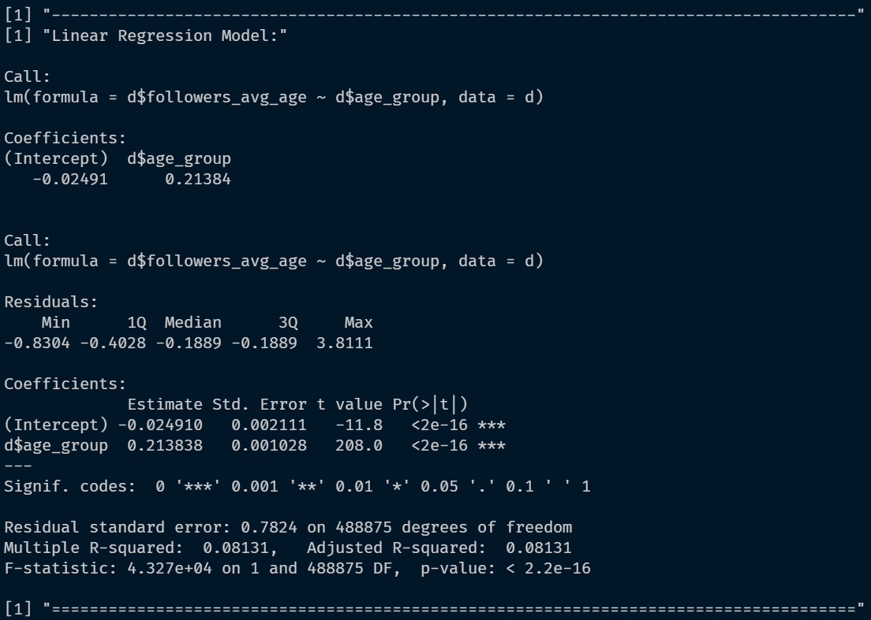
Linear Regression Model (Age Grp vs Followers Avg Age)
Correlation obtained from the model:
0.2851477
Obtained Linear Regression equation:
y=-0.02491x+0.21384

Slide 19
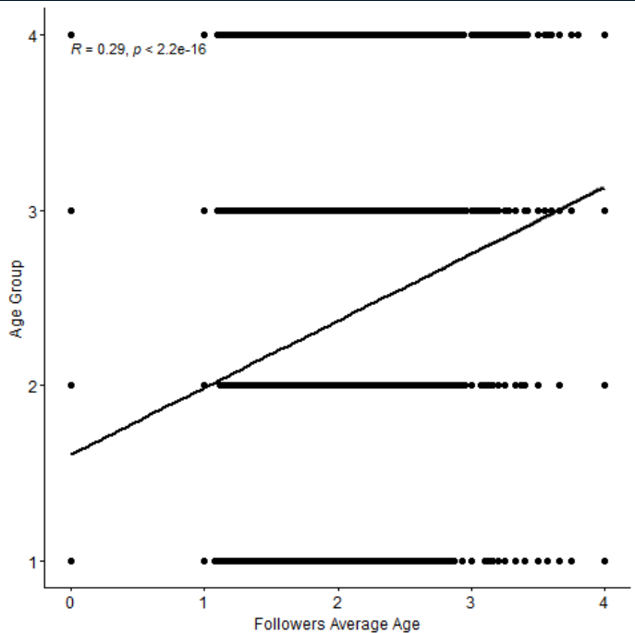
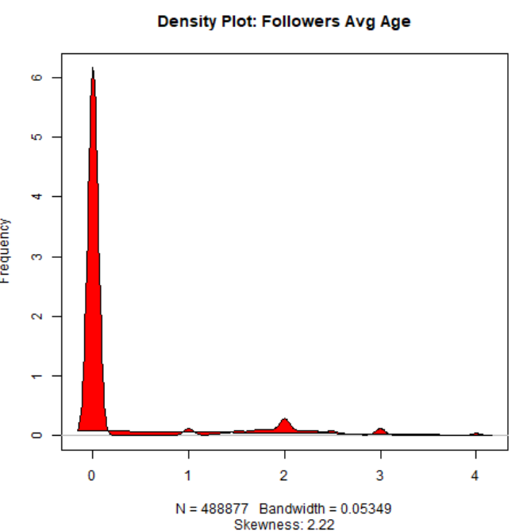
Line of Regression:
Density Plot:

Slide 20

Linear Regression Model (Age Grp vs Following Avg Age)

Slide 21
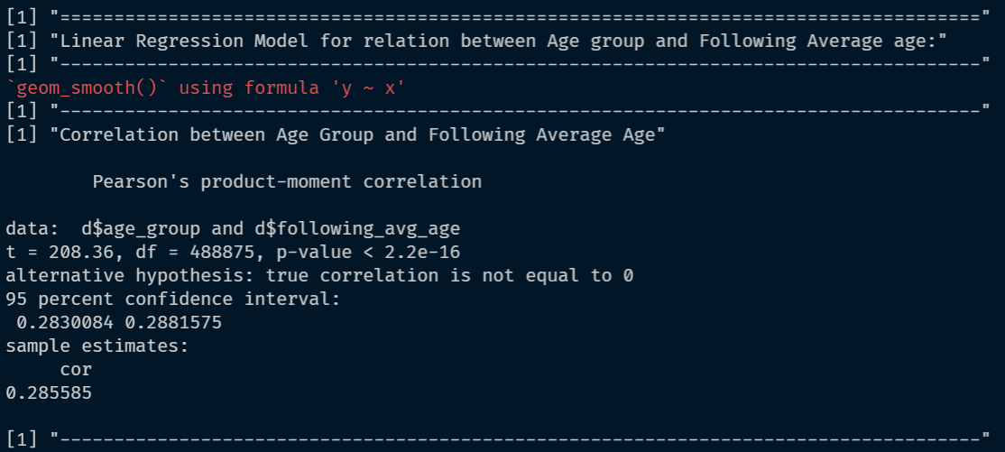
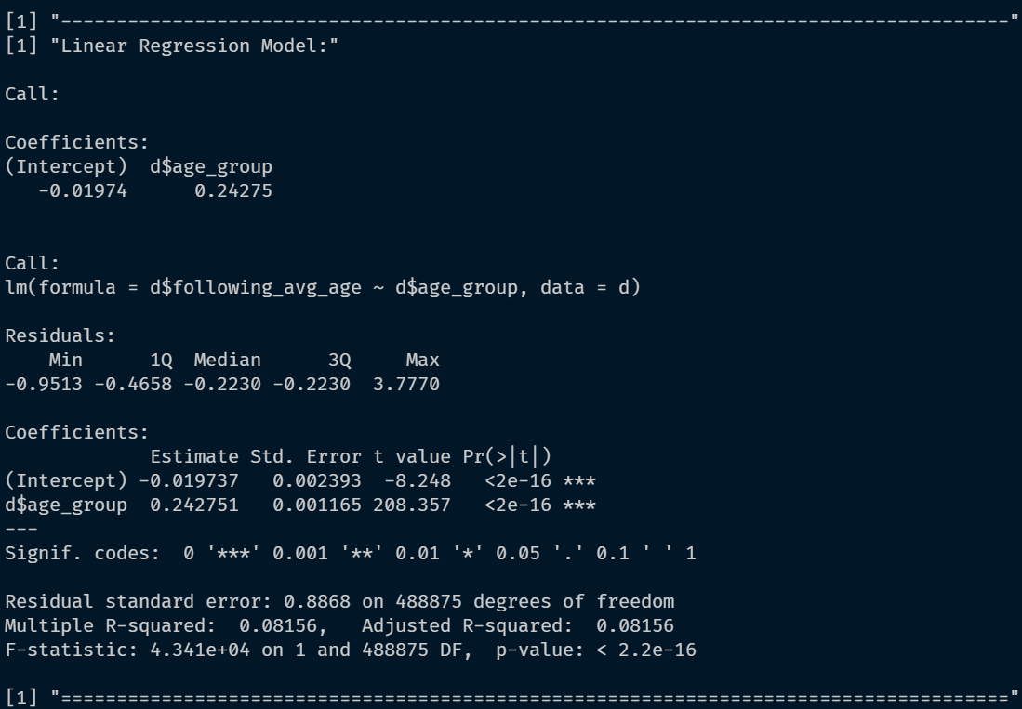
Linear Regression Model (Age Grp vs Following Avg Age)
Correlation obtained from the model:
0.285585
Obtained Linear Regression equation:
y=-0.01974x+0.24275

Slide 22
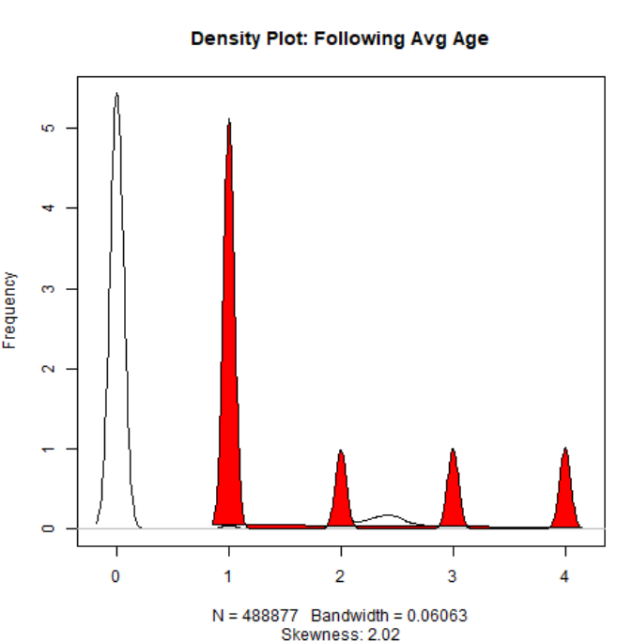
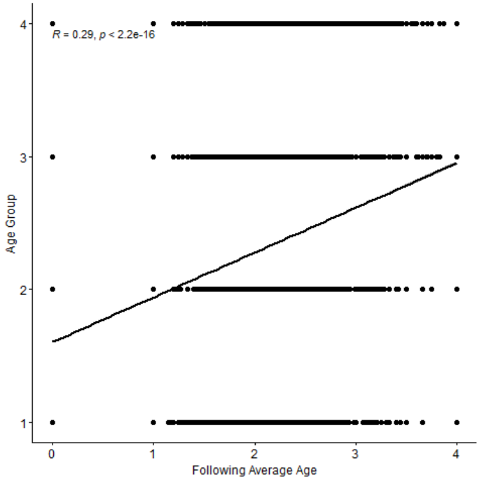
Line of Regression:
Density Plot:

Slide 23
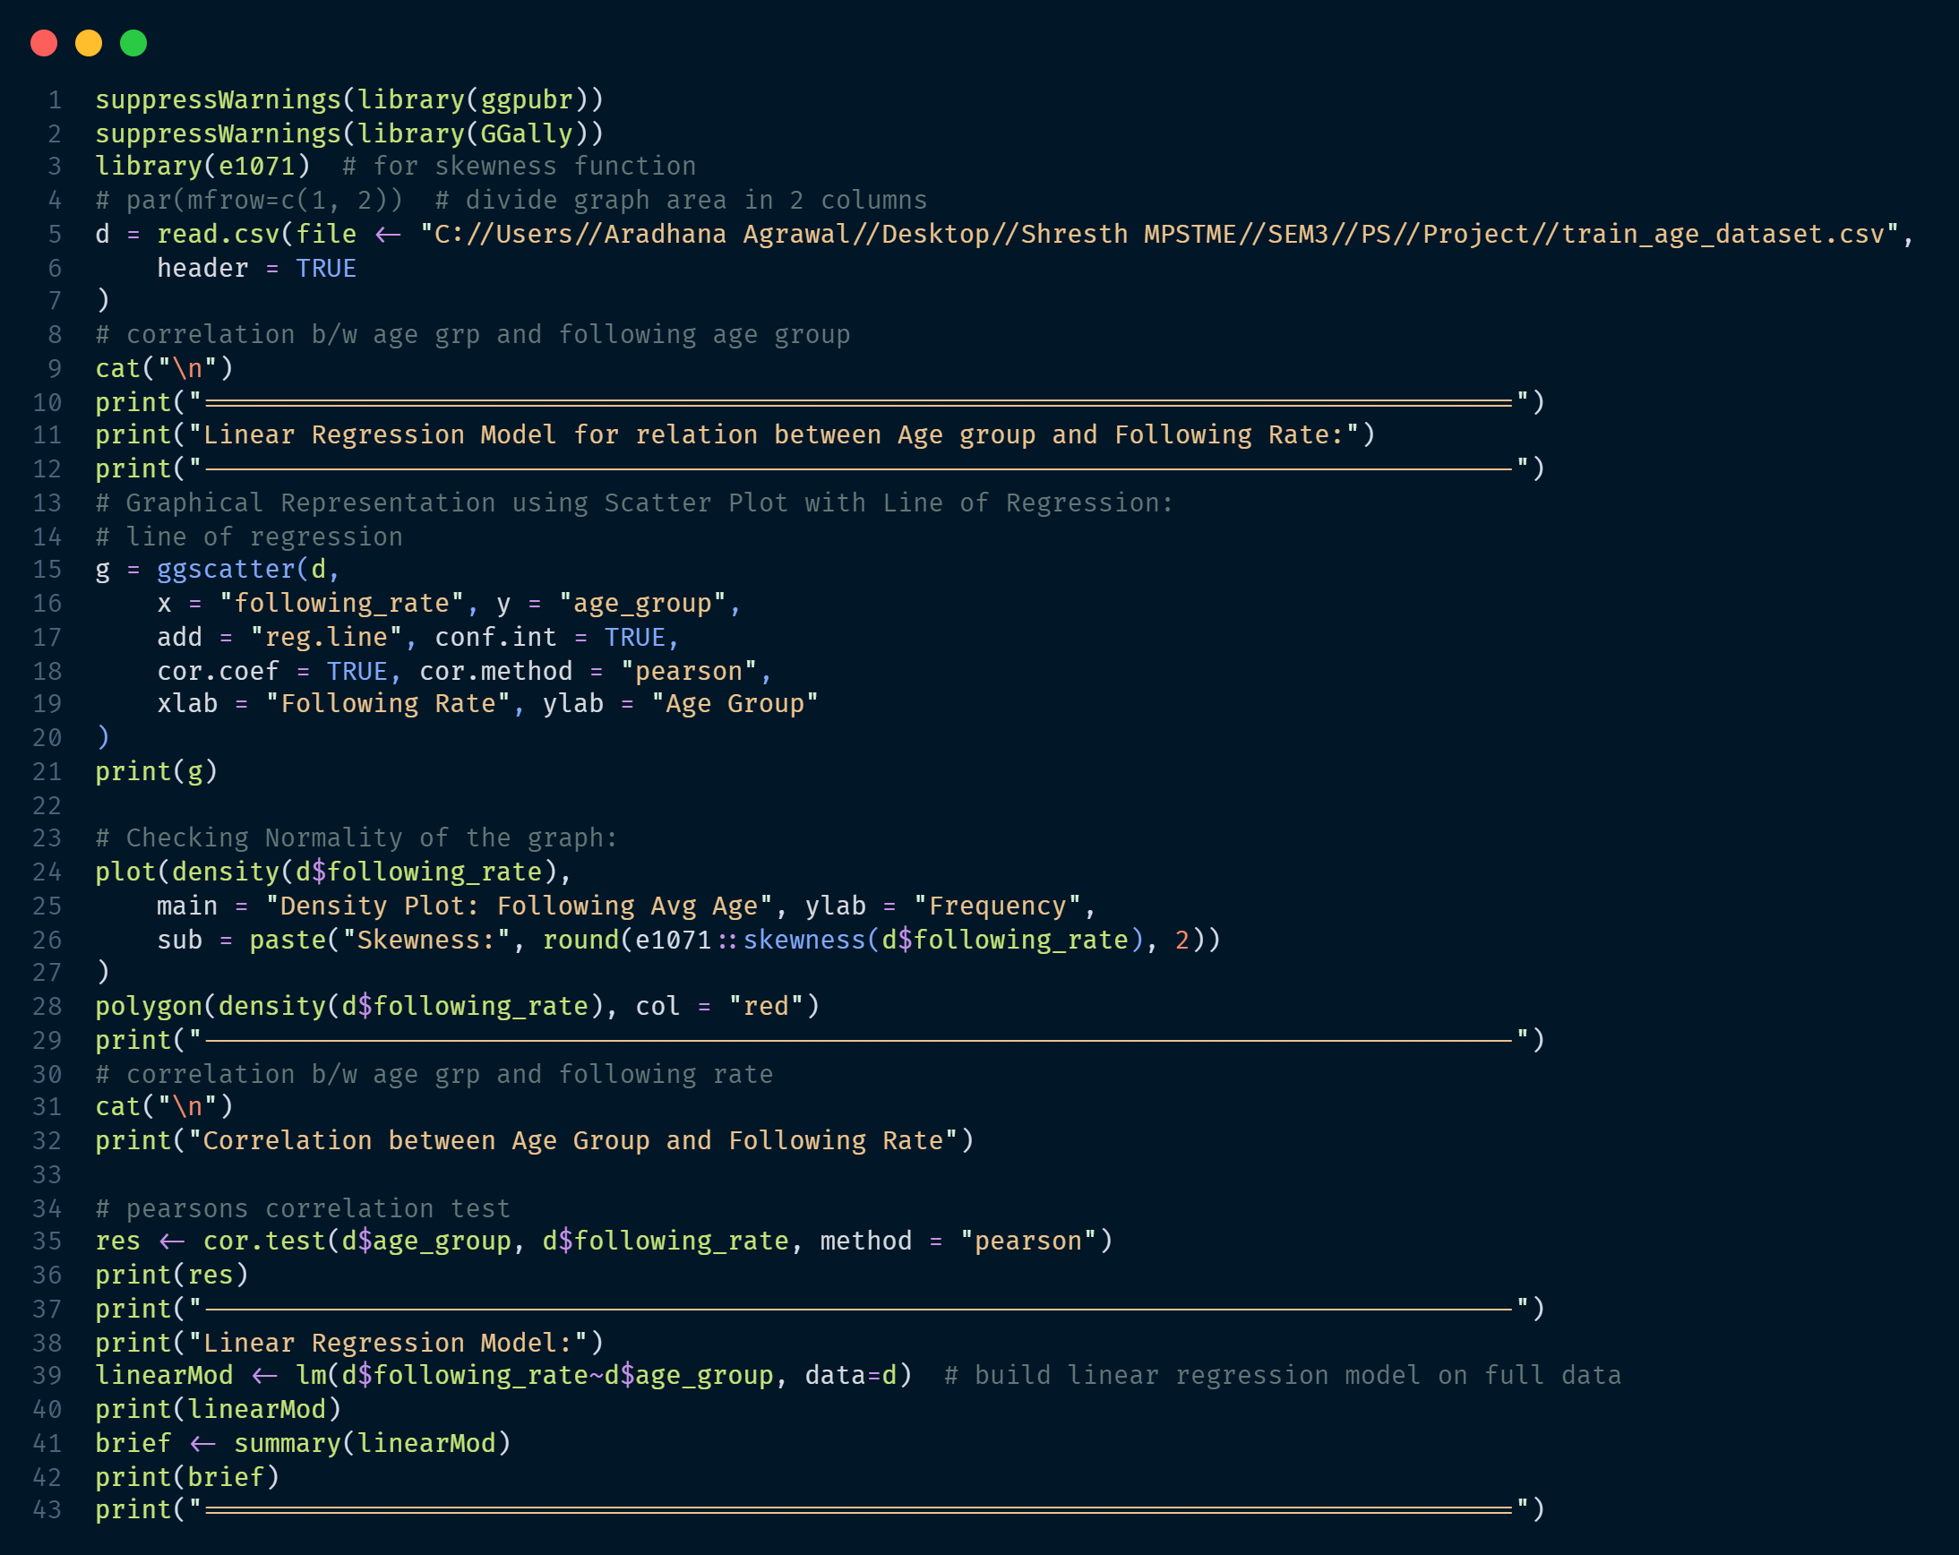
Linear Regression Model (Age Grp vs Following Rate)

Slide 24
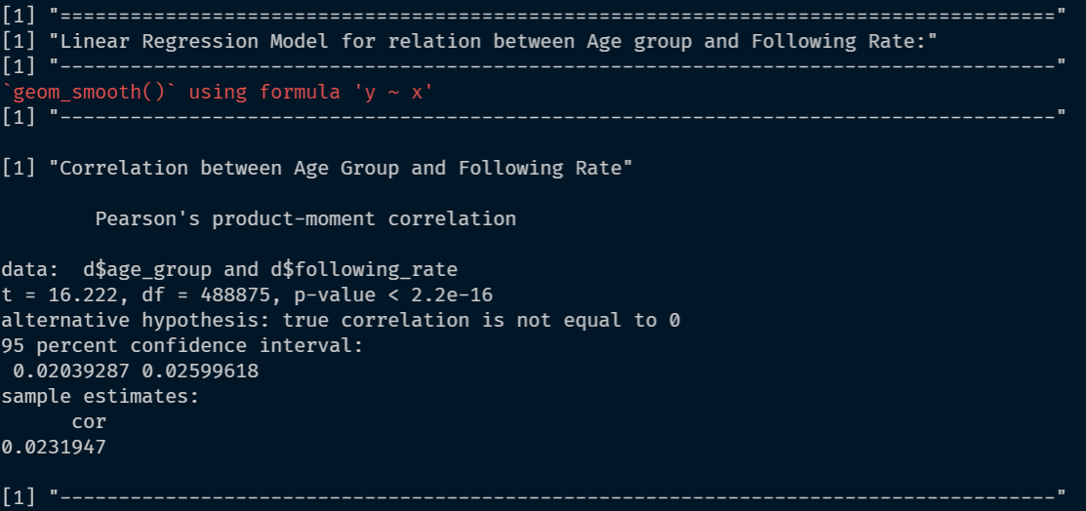
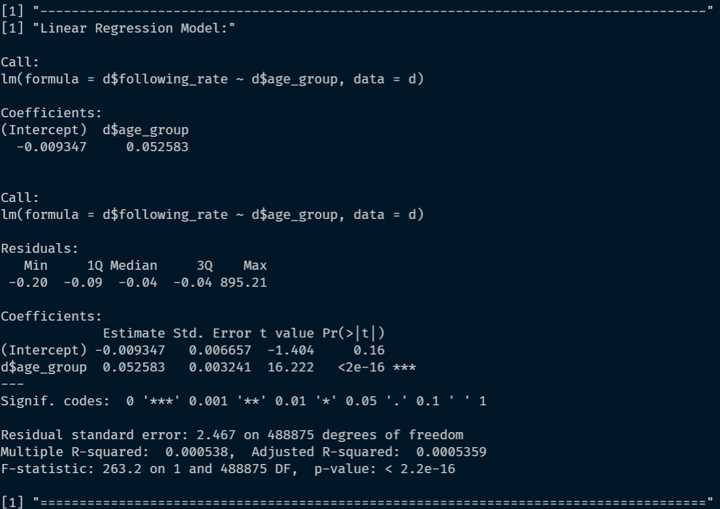
Linear Regression Model (Age Grp vs Following Rate)
Correlation obtained from the model:
0.0231947
Obtained Linear Regression equation:
y=-0.009347x+0.052583

Slide 25
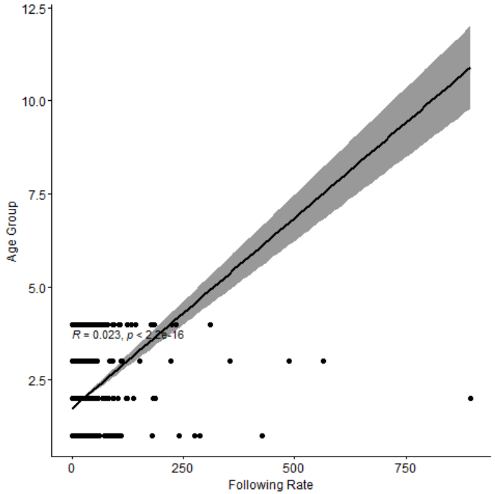
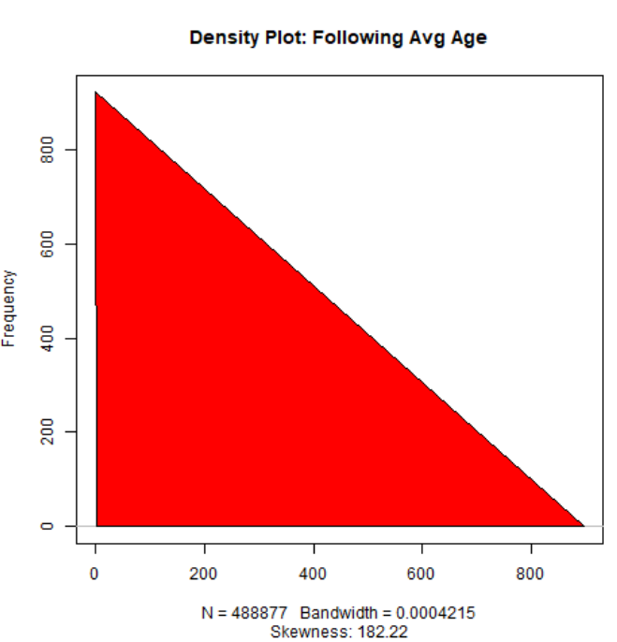
Line of Regression:
Density Plot:

Slide 26
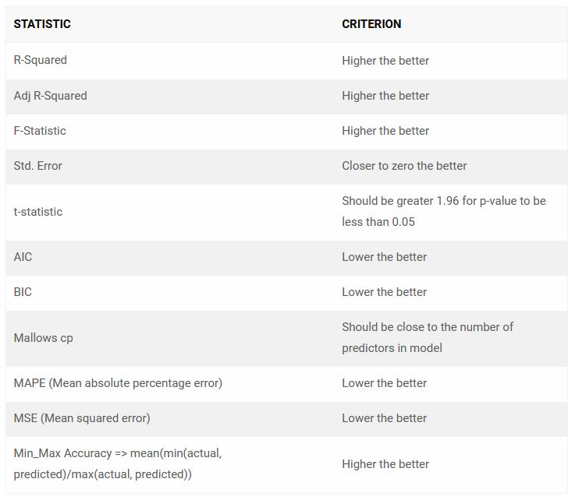
Which rgression Model is the Best?

Slide 27
Conclusion
Correlation between age group and various variables like following avg. age, followers avg. age and following rate showed with the help of linear regression model. This algorithm can be used to effectively target the correct audience, using social media and hence, save marketing expenses.

Slide 28
Thank You

